Slide 1
Data Wrangling

Slide 2
Notebook Environments
Mixing code, data, computational results, and text are essential for projects to be:
reproducible
tweakable
documented.

Slide 3
Data Wrangling/ Data Munging/ Data Munching
Good data scientists spend most of their time cleaning and formatting data.
The rest spend most of their time complaining there is no data available.
Data munging or data wrangling or data munching is the art of acquiring data and preparing it for analysis.

Slide 4
What is Data Wrangling/ Data Munching?
Baseball: An example to demonstrate the concept
Player | Position | L or R? | Average
A | outfield | L | 0.295
B | shortstop | R | .315
C | outfield | L | 0.349
D | outfield |  | 0.319
E | outfield | L | 1.110

Slide 5
What is Data Wrangling/ Data Munching?
Data wrangling is the art of dealing with and or converting missing or ill-formatted data into a format that more easily lends itself to analysis.
Before analysis, we first have to get Data.
Most common Data sources:
files, databases, and websites

Slide 6
What is Data Wrangling/ Data Munching?
Data wrangling is the art of dealing with and or converting missing or ill-formatted data into a format that more easily lends itself to analysis.
Before analysis, we first have to get Data.
Most common Data sources:
files, databases, and websites

Slide 7
Analysing Messy Data
Have you ever had to analyze really messy or unorganized data?
What methods or tools did you use to make your life easier?
The Data is often messy and unorganized:
a large amount of a data scientist's time is spent extracting and cleaning the data that they will use to perform analyses or make visualizations.

Slide 8
Aquiring Data and Data Formats
Often doesn’t require any fancy methodolgy
Data is available in a variety of formats:

Slide 9
Standard Data Formats
Historically, computer scientists would rather share a toothbrush than a data format.
But accepted standards are now available:
CSV files: for tables like spreadsheets
XML: for structured but non-tabular data.
JSON: Javascript Object Notation for APIs.

Slide 10
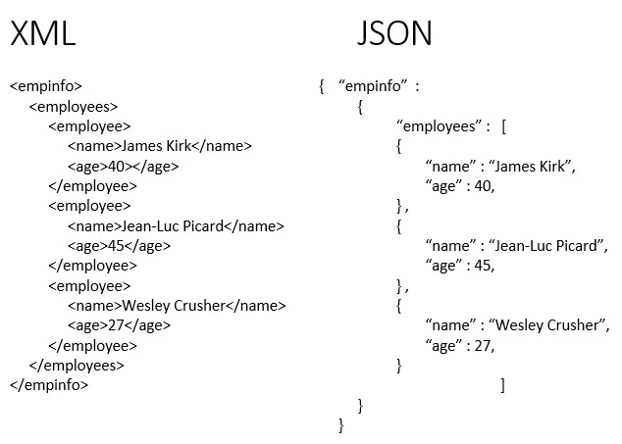
Standard Data Formats
CSV
name, salary, age
abc, 100000, 28
Xyz, 150000, 30

Slide 11
Data Sources
Files
Relational Databases
APIs (to access data from some website)
For example APIs, look at:
https://developer.twitter.com/en/docs/tweets/search/api-reference/get-search-tweets.html
https://www.last.fm/api

Slide 12
Web Search/Scraping
Scraping is the fine art of stripping text/data from a webpage.
Libraries exist in Python to help parse/scrape the web, but first search:
Are APIs available from the source?
Did someone previously write a scraper?
Terms of service limit what you can legally do.

Slide 13
Sanity Data Checking
Now that we have acquired our data, whether the informal flat file sequel like relational database, or an API, you might think that you are ready for analysis.
Not yet: There can be some problem with the data.
Incorrect format or
Missing values

Slide 14
Sanity Data Checking
What does it mean to Sanity Checking our Data?
Determining does the data make sense?
Is there a problem?
Does the data look like I expect it to?

Slide 15
Pandas Describe Function
describe returns a data frame in it of itself.
For every numerical column, we see the count, mean, standard deviation, mean, 25%, 50%, 75% and maximum values.
We can do some quick checking to make sure there are data generally make sense.

Slide 16
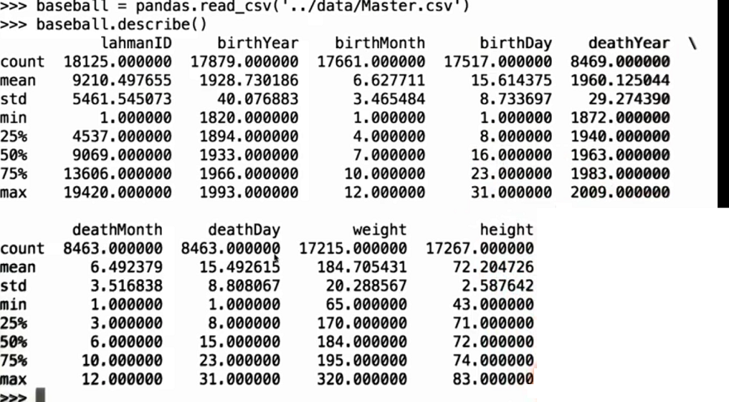
Pandas Describe Function

Slide 17
Why values are missing?
Occasional system failures/ errors, prevent data from being recorded.
Some subset of subjects or event type are systematically missing certain data attributes, or missing entirely.

Slide 18

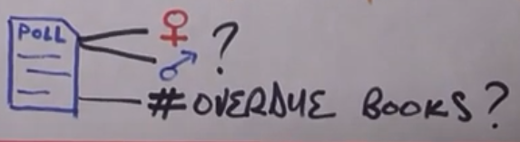
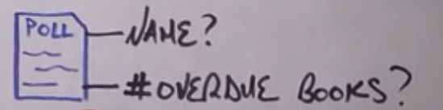
Type of Missing Data (Missing Data Mechanisms)
Missing completely at random (MCAR)
Missing at random (MAR)
Missing not at random (MNAR)
https://towardsdatascience.com/all-about-missing-data-handling-b94b8b5d2184

Slide 19
Dealing with Missing Data
Partial Deletion
Impution
Partial Deletion
Listwise Deletion
Pairwise Deletion

Slide 20
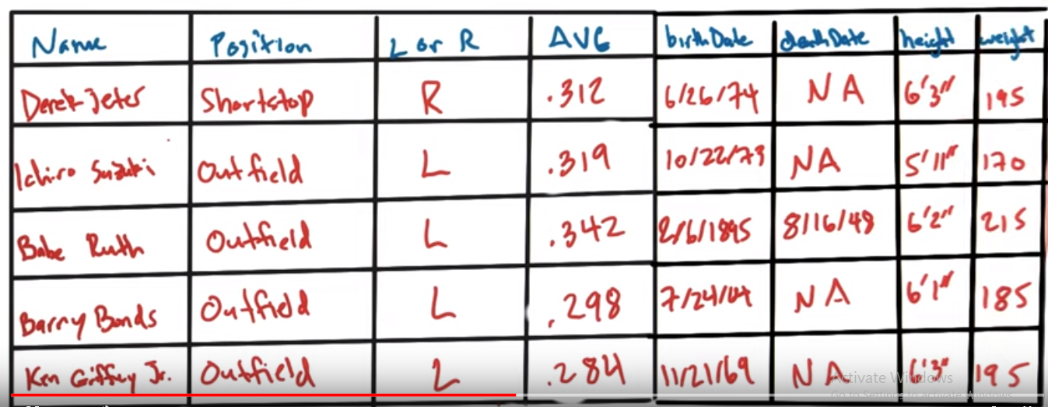
Deletion: Listwise and Pairwise
Analysis 1: What is the average life span of a baseball player?
Analysis 2: What is the average height of a baseball player?

Slide 21
Why Imputation
In Scenarios where we don’t have very much data OR
where removing our missing values would compromise the representativeness of our sample.
it might not make sense to throw away a bunch of our entries just because they're missing values.

Slide 22
Why Imputation
This can severely impact the statistical power of whatever analysis we are performing.
In this case, it likely makes sense to make an intelligent guess at the missing values in our data.
The process of approximating these missing values is referred to as imputation.

Slide 23
Imputation Methods
Several Methods and Techniques available
Two of the Methods are:
Impute using Mean value
Impute using Linear Regression

Slide 24
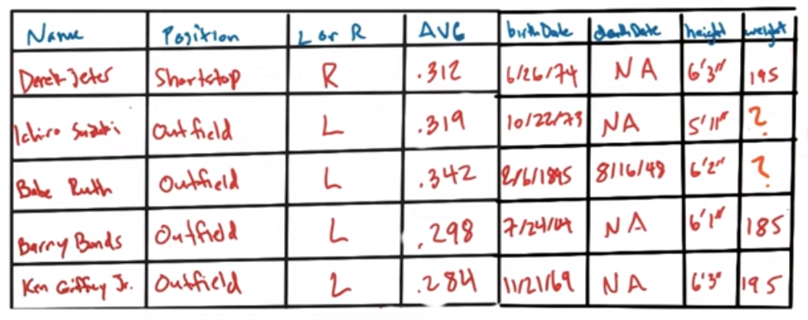
Imputation using Mean
Good: does not change mean across sample
Bad: lessen correlations between variables

Slide 25
Imputation using Linear Regression
Suppose we have a dataset with features (f1, f2, f3, f4, f5) and an output varibale y.
Suppose some values of f1 are missing and we want to impute using Linear Regression.
Approach:
The data examples which have missing f1, is considered as test data.
All other data is taken as training data
Consider f1 as output varible and others (f2, f3, f4, f5) as features and train the model using training data.
Then predict f1 of missing data using the trained model.

Slide 26
Languages for Data Science
Python: contains libraries and features (e.g regular expressions) for easier munging.
R: programming language of statisticians.
Matlab: fast and efficient matrix operations.
Java/C: language for Big Data systems.
Mathematica/Wolfram Alpha: symbolic math.
Excel: bread and butter tool for exploration.

